Slide 1
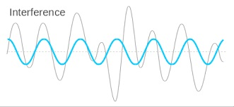
Stopping Radio Interference for Fun and Profit:
Electromagnetic Compatibility (EMC) as a Goal, a Technology, and a Career
Thomas E. Braxton, NCE
IEEE Life Senior Member
tbraxton@ieee.org

Slide 2

Tom Braxton has worked in electromagnetic compatibility and regulatory compliance for 42 years, beginning at Bell Labs. He was later an independent EMC consultant and then a compliance engineer with Shure Incorporated. He has consulted in patent law, product-test marketing, and standards development.
Tom is a Life Senior Member of the IEEE and a member of the IEEE EMC Society since 1981. He is an iNARTE Certified EMC Engineer and ESD Engineer, has served two terms on the EMC Society Board of Directors, and currently chairs Technical Committee 1 (TC1) on EMC Management. Tom chaired the 2005 IEEE EMC Symposium in Chicago and is Vice-Chair of the EMC Society Chicago Chapter. He has presented and published numerous papers on EMC topics and is an Associate Editor of the EMC Society Magazine. Tom has a BSEET from Purdue University, an MSEE from the Illinois Institute of Technology, and holds Amateur Radio license WB9VRW.

Slide 3
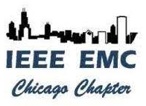


This presentation is brought to you by the IEEE EMC Society Chicago Chapter
Electromagnetic Compatibility (EMC) is defined by the International Electrotechnical Commission (IEC) as the ability of equipment or a system to function satisfactorily in its electromagnetic environment without introducing intolerable electromagnetic disturbances to anything in that environment.
EMC is a goal of every electronic manufacturer. No one wants to worry about a product failing because of radio interference.
EMC is a technology, with its own guidelines, practices, components, and folklore.
EMC is a career that’s growing more important as wireless devices embed themselves deeper into our lives. And it’s more fun than writing code or working in IT.

Slide 4
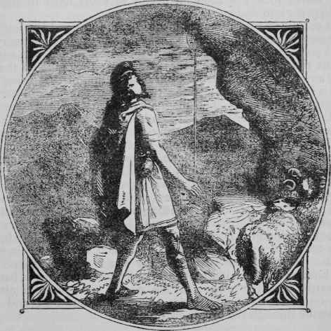
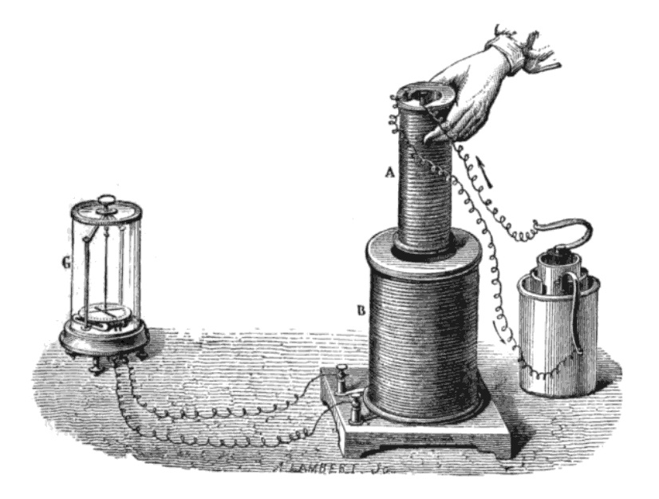
Staff stuck on lodestone
In the beginning…
4,000 years ago, Magnes, a Greek shepherd, found that his staff’s metal tip was stuck to a rock. He dug out the rock, which became known as lodestone. Magnetism became common knowledge for thousands of years, though no one understood how it worked.
Faraday’s Hand
Galvanometer
Liquid Battery
Fast forward to 1831: Michael Faraday showed that an oscillating magnetic field would produce an electric current in a wire.
Wire
Coils

Slide 5
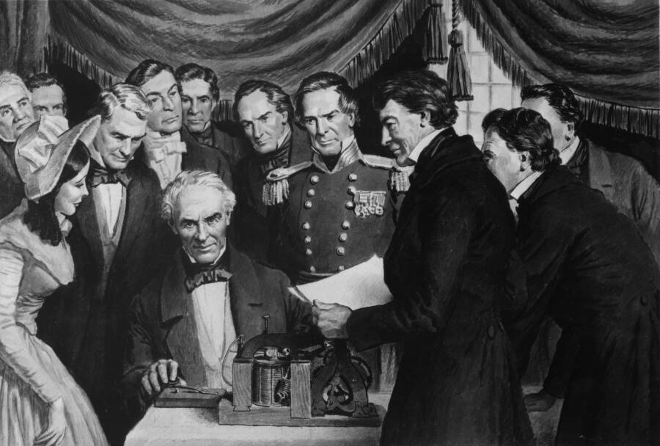
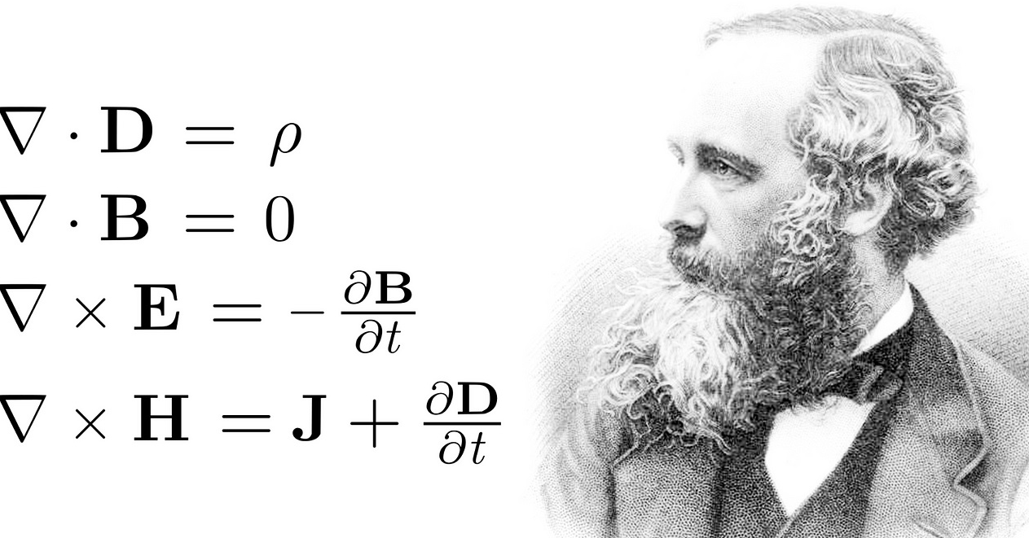
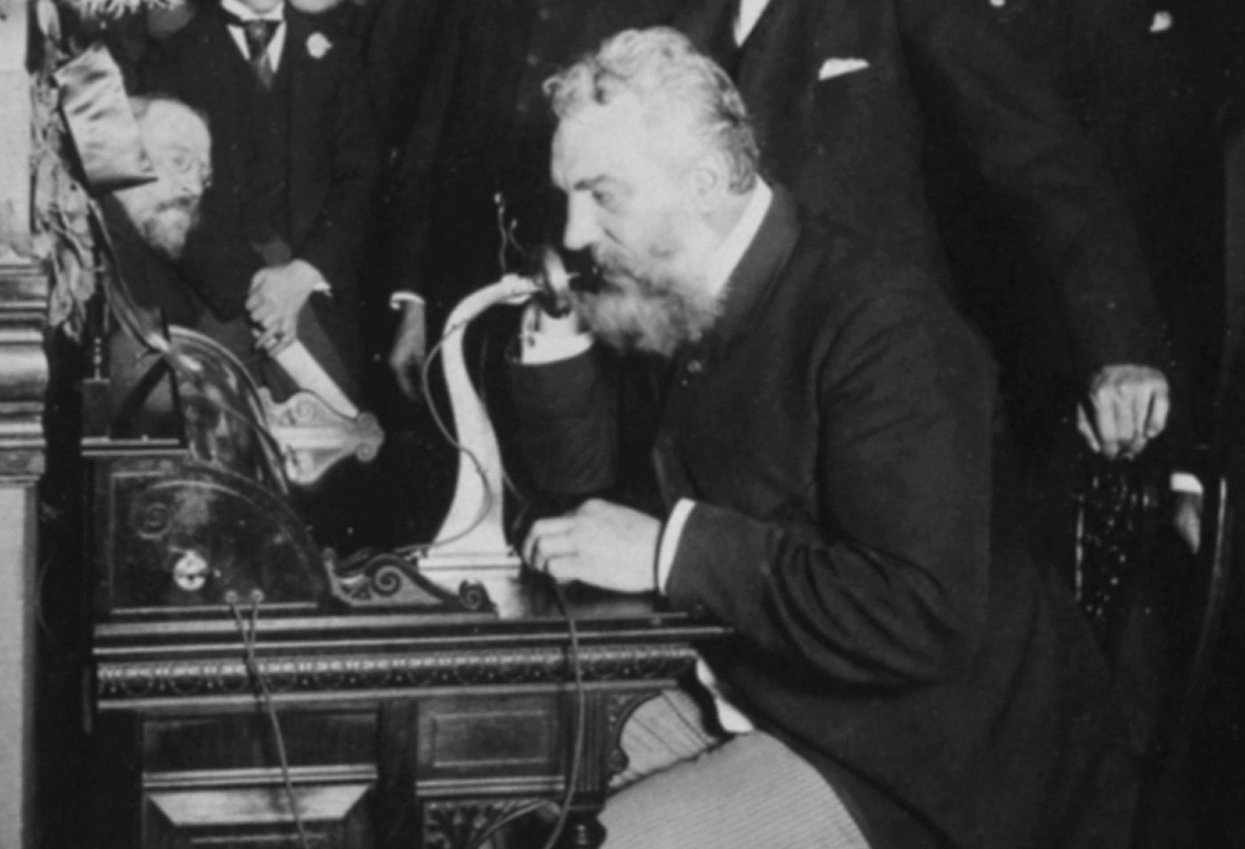
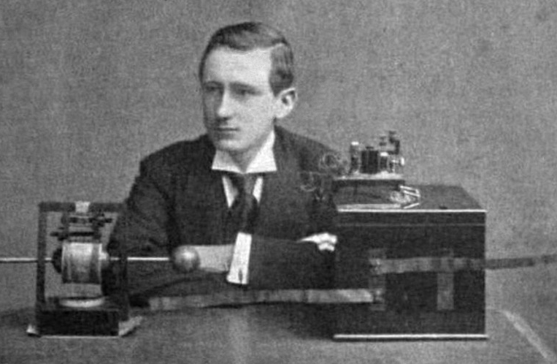
Things were happening fast in those years.
Samuel Morse invented the telegraph in the 1830s, using Faraday’s principles to communicate by wire.
Morse tapping out a message
James Maxwell’s 1865 equations showed the connection between magnetic and electric fields.
Maxwell and his equations
In 1876, A.G. Bell invented the telephone, sending voice by wire. In 1880, Heinrich Hertz proved radio waves exist. By 1894 Guglielmo Marconi had developed a wireless telegraph.
Bell making a call
Marconl with radio, thinking

Slide 6
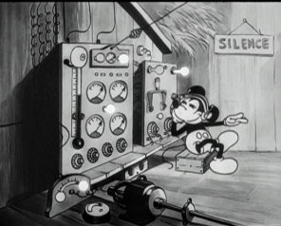
After Marconi made it practical, radio was everywhere.
Radio proved essential in 1912 with the sinking of the Titanic. Survivors were rescued because wireless distress messages were received by the Carpathia.
Later developments by DeForest and Armstrong made wireless audio practical. AM broadcast came first, then FM, later television, two-way, microwave, and the rest. Everybody had, and still has, a wireless device of some kind.
With so many signals in the air, they were bound to interfere with each other. And they have, since the very beginning.
DJ Mickey M

Slide 7
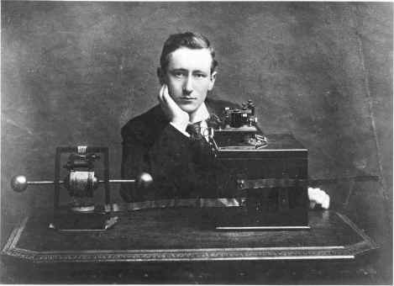
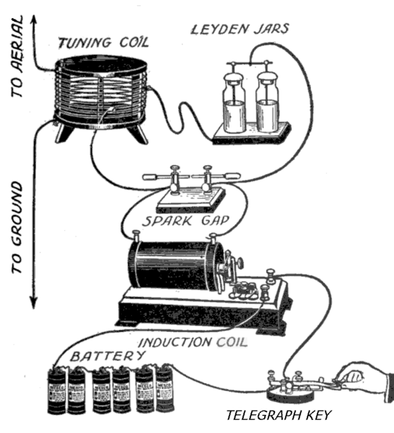
Interference has always been the wireless companion.
Marconi with radio, still thinking
Marconi had the first interference problem with his original wireless telegraph.
When early customers complained that their spark transmitters interfered with each other, he had to find a way to fix it. His staff learned how to operate on different frequencies, making them electromagnetically compatible.
Spark gap transmitter schematic

Slide 8
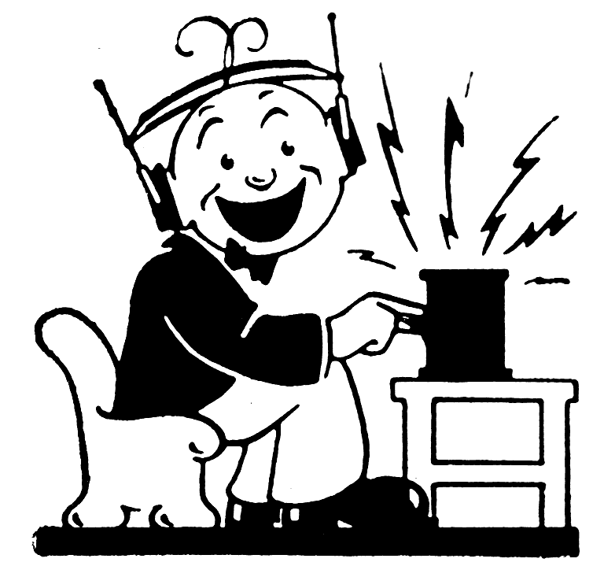
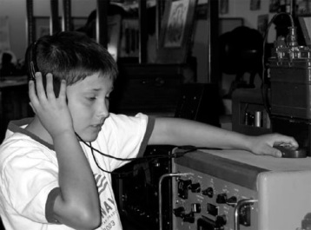
How did I get into this?
These aren’t pictures of me, but they could have been.
Radio has fascinated me since I was a kid, and interfering signals have always frustrated me. You can’t communicate if a signal is blocked or corrupted.
In 1980, the FCC issued new emission limits on electronic devices. My job at the time became measuring interfering signals and ways to troubleshoot interference problems.
Radio activity

Slide 9
So, what is Electromagnetic Compatibility (EMC) in the real world?
There’s an important difference between EMC (Compatibility, which is good) and EMI (Interference, which is bad).
EMC is ultimately a product-quality concern, and it’s often a public-safety issue.
EMI requires 3 elements: an EM source, a path, and a victim device:
SOURCE
PATH
VICTIM
Simple in concept, challenging in practice.

Slide 10
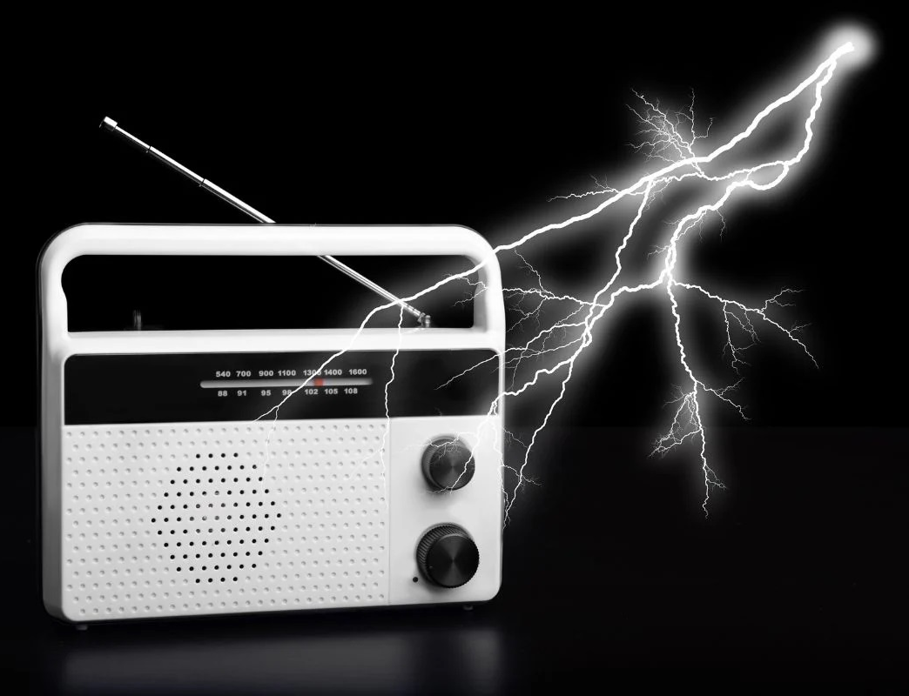
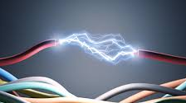
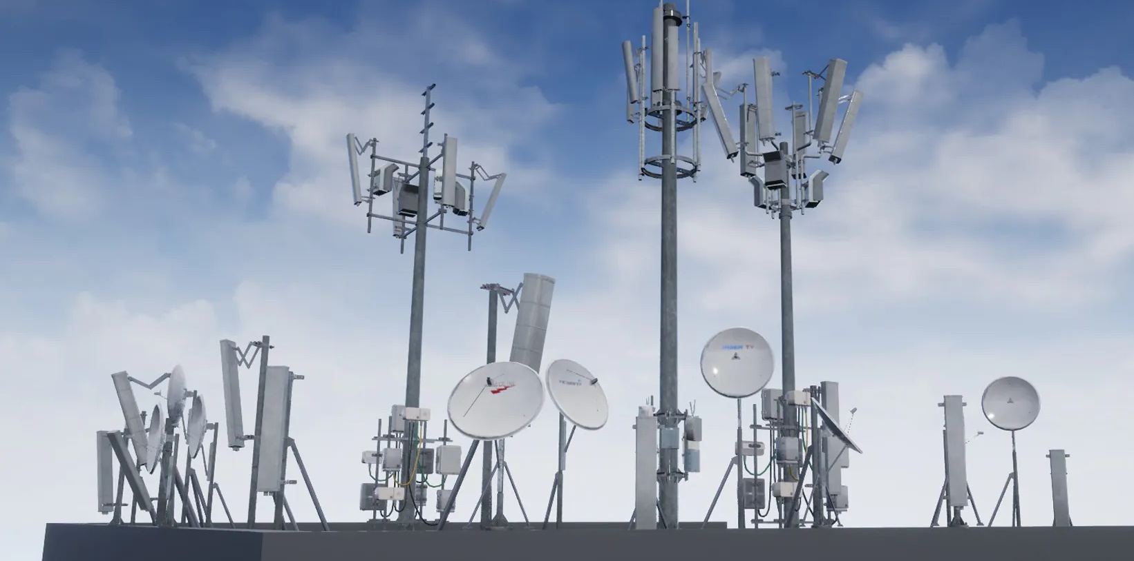
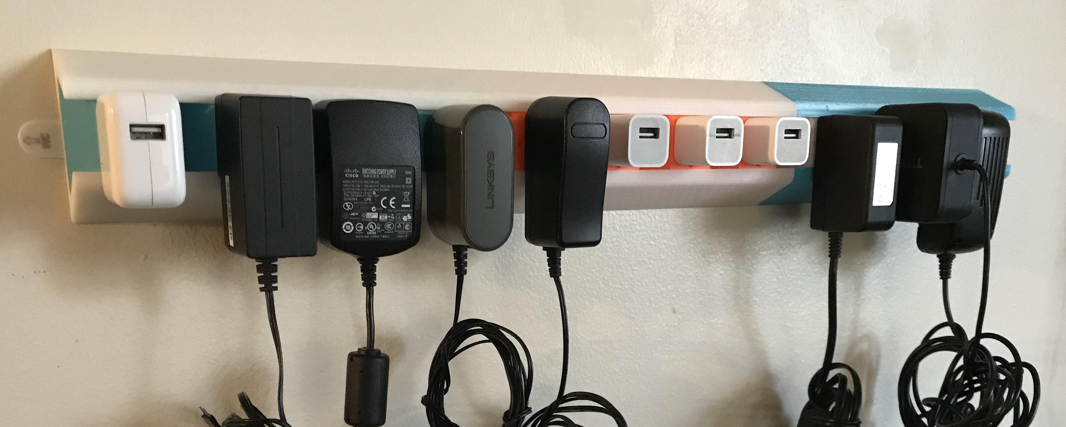
Where does EMI come from?
Electrical disturbances
  What we think of as static: lightning, poor wiring, fluorescent lights
Radio transmitters
  Broadcast
  Cellphones
  Garage-door openers, key fobs, Wi-Fi
Digital devices -- anything with a microprocessor or internal clock
    Switching power supplies
    Laptops
    Appliances
    Office equipment
    Nearly everything
Electrical noisemaker
Lightning interference
Antenna farm
Switching power supply noisemakers

Slide 11
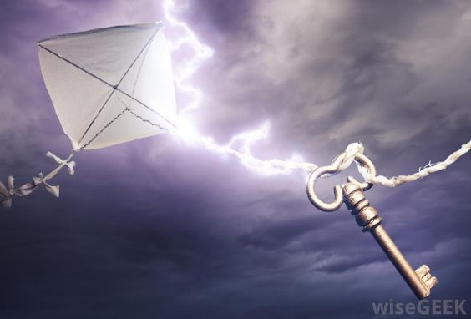
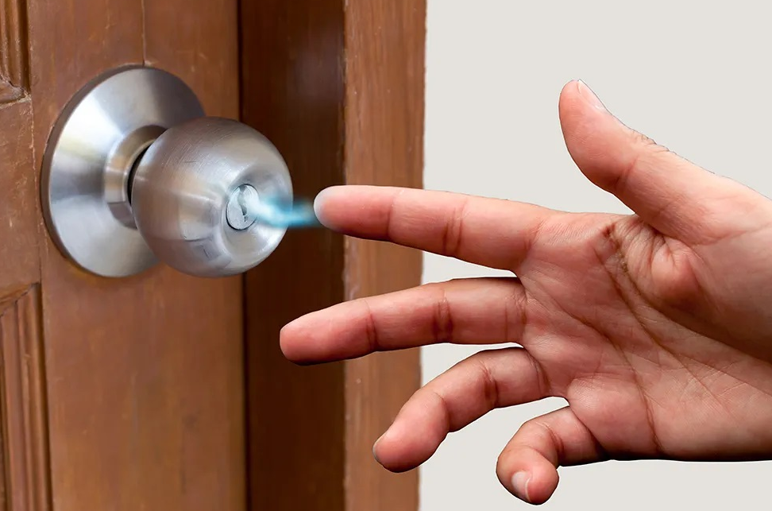
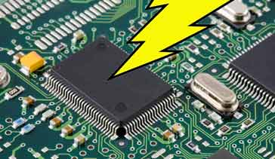
Electrical Noise
Ben Franklin confirmed that lightning is an electrical discharge on a very large scale. When it happens, a momentary electrical field is given off.
This is the same phenomenon as the electrostatic discharge (ESD) you feel on your finger after pulling off a wool sweater in the winter months.
In both cases, an abrupt, transient field is given off that is detected by a radio and other electronic devices.
On the radio, you hear a pop or a crack. In a digital device, that transient can cause an interruption in the microprocessor circuit.
The effect is the same when it comes from poor electrical connections.
Ben Franklin’s kite (dramatization)
A local doorknob
ESD hitting circuit board (not to scale)

Slide 12
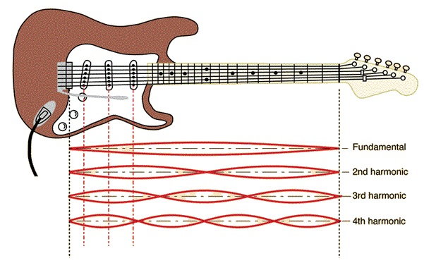
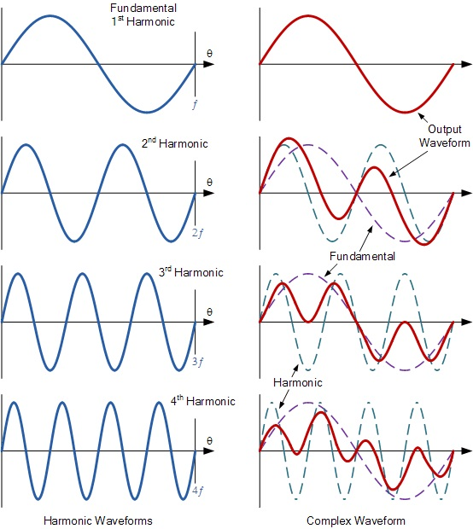
Harmonics
A plucked guitar string will create standing waves on itself that are fractions of its length, generating harmonic frequencies of different audio wavelengths.
Similarly, a radio signal has a fundamental frequency. Any transmission path, whether radiated or conducted, is not ideally linear. Those non-linearities will create harmonic frequencies seen as multiples of the fundamental frequency.
Those unintentional harmonic signals can create interfering frequencies far removed from the intended fundamental frequency.
To minimize EMI, careful circuit design minimizes the level of harmonic frequencies generated in a circuit.
Harmonics from Stratocaster
Harmonics from broadcaster

Slide 13
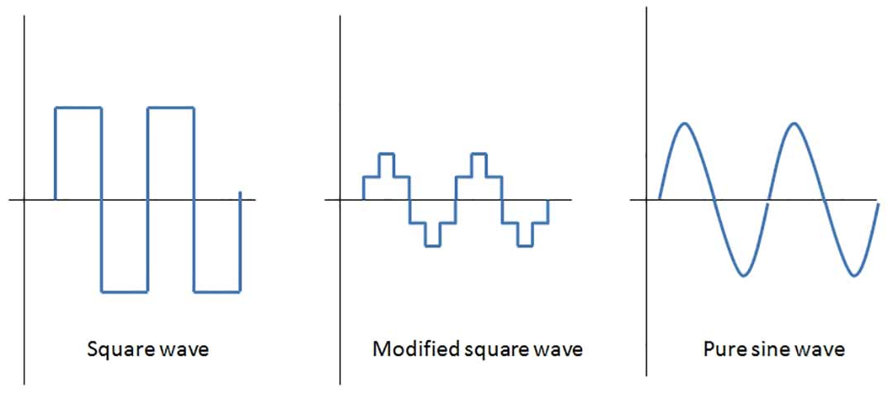
Fast Rise Times
As digital circuits increase in speed, the need increases for clean waveforms. The logic circuits need to tell the difference between a high and a low pulse.
The problem is that the faster the rise time, the more harmonics are generated, creating more EMI. A square wave is a distorted sine wave made up of harmonics squeezed together.
Though high-speed circuits require fast signal transitions, careful circuit design minimizes the splatter of harmonics created by the faster rise times.

Slide 14
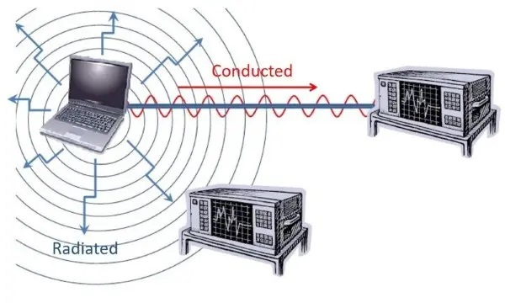
What path does EMI use to get into something?
Generally, there are two ways EMI gets from the source to the victim:
Radiated -- the signal travels through the air. Exposed metal, cables, conductive structures all act as antennas on a device exposed to EMI.
Conducted – the signal is carried in through wires or other metal, often because the radiated EMI is picked up by those cables or exposed metal.
Usually, it’s a combination of both.
Spectrum analyzer
Another spectrum analyzer

Slide 15
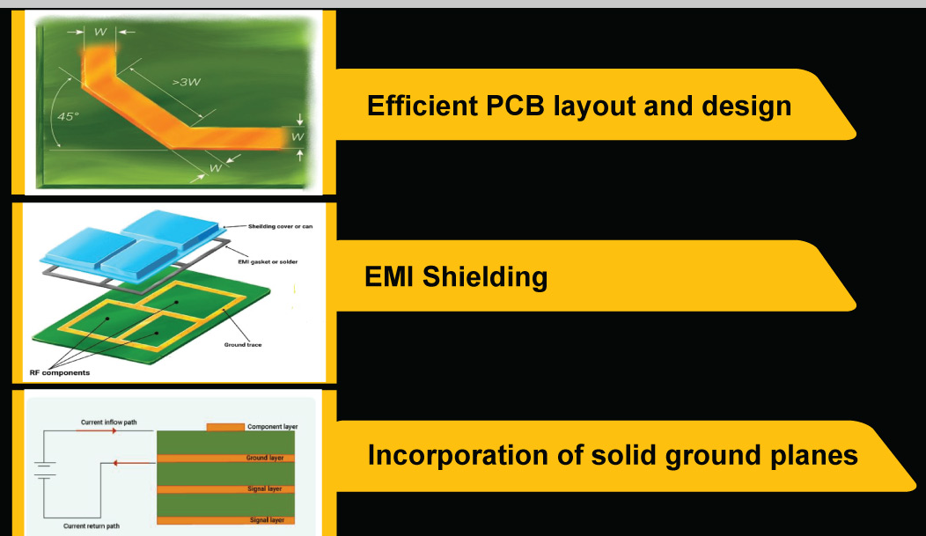
So how do we fix it?
First step is prevention: minimize emissions in the product design.
Design rules exist that will keep EMI to a minimum:
Limit current in on-board signals.
Provide sufficient circuit ground area to provide low-impedance current return paths.
Match impedances between on-board signal drivers and signal receivers.
Provide decoupling/bypass capacitors as needed on high-speed signal paths.
Minimize signal path lengths.
Stack up circuit board layers with enough circuit- ground area.
Shield devices that are likely to be noisy.
Eliminate enclosure gaps and shield cable connectors
Some printed circuit board design options

Slide 16
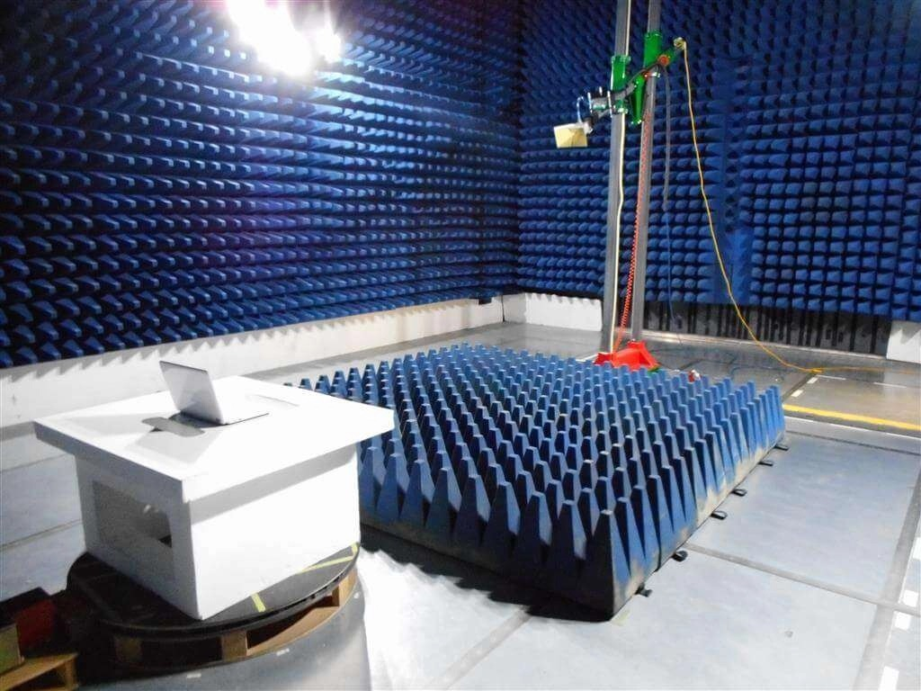
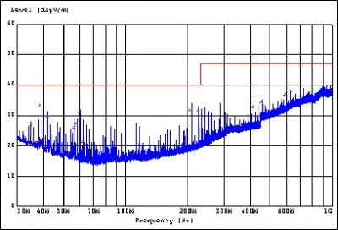
At this point, an EMC test is done to measure the device’s emission and immunity level.
Depending on what standard or customer requirement the device needs to meet, tests of radiated and conducted emissions and EMI immunity are performed in an EMC laboratory.
Following the mandated test procedures, radiated emissions are measured across a specified frequency range and compared to the limit given in the standard.
Similarly, tests of conducted emissions from any cables connected to the product are performed against the applicable standard.
If required, radiated and conducted immunity tests are performed. The device is exposed to radiofrequency fields at specified levels and frequency ranges given in the applicable standard.
Electrostatic discharge (ESD) tests are usually performed as well, testing the device’s immunity to sudden transients. Depending on the device, it may also require power surge and transient-burst immunity tests.
EMC test lab
Limit line
Emission levels from spectrum analyzer

Slide 17
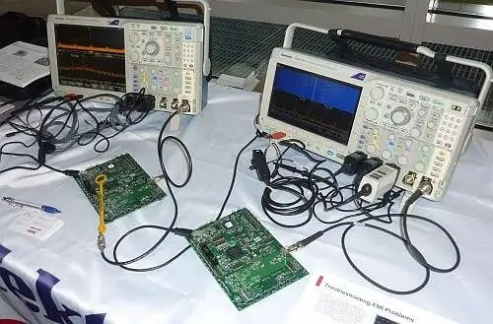
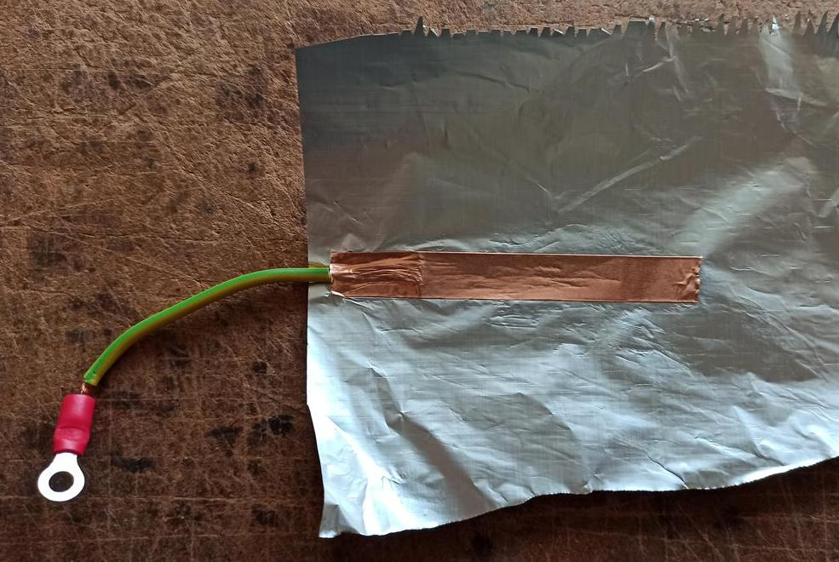
It’s already designed and doesn’t pass a regulatory emission test – what can be done?
All is not lost. There are mitigation steps that can be applied to finished products.
Like in any troubleshooting, analyze the problem.
  Where’s the EMI coming from?
  What frequencies are over the limit?
  Are all connectors and the enclosure secure?
Is there a simple fix that might help?
  Additional shielding
  Input/output cable filtering
Experiment with simple fixes. If they don’t help, work with the designer to identify what parts of the circuit could generate the problem frequencies.
EMC troubleshooting bench
Aluminum foil shield experiment

Slide 18

Troubleshooting an EMI Immunity Problem
The same troubleshooting techniques apply: analyze the problem.
How is the device failing when exposed to an EM field?
  Does it inhibit its operation?
  What happens when it fails?
  Is the failure consistent after repeated tests?
  At what frequencies does it happen?
Talk with the designer to find out what part of the device would cause this response and troubleshoot from there.
A lot of trial-and-error may be necessary.
EMC engineer in thoughtful pursuit of an answer

Slide 19
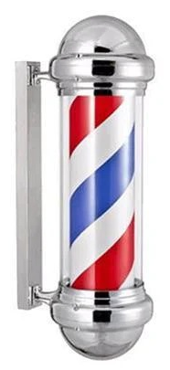
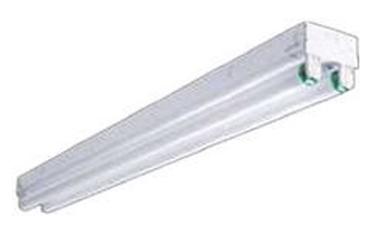

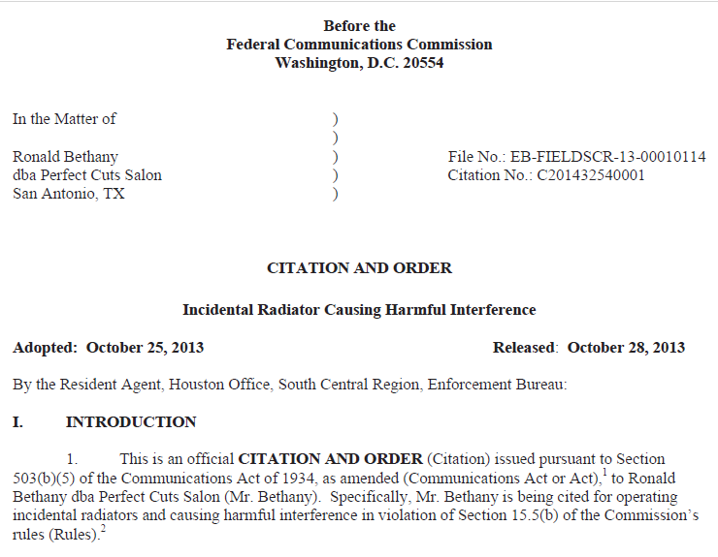
This really happens – here’s a story.
Fluorescent light fixtures at a hair salon in San Antonio, Texas, caused interference to a nearby AT&T cell site. The FCC tracked the problem to the salon’s lights and told the owner to replace them. When the owner pushed back, the FCC issued a citation against the hair salon after some bickering over who would pay for the replacement of the offending lights.

Slide 20
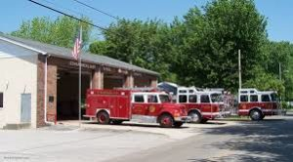
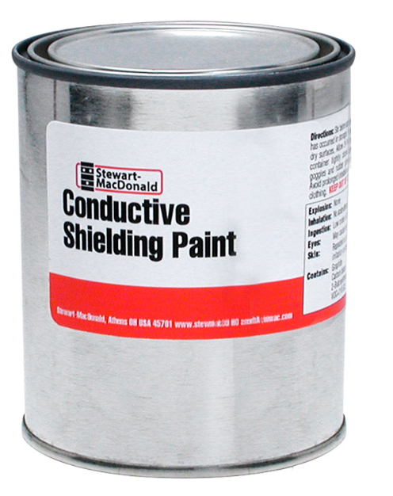
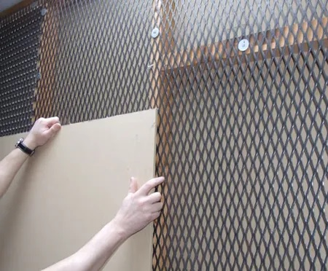

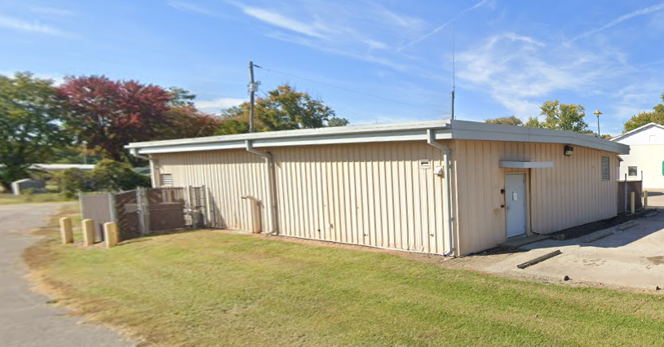
This really happens – another story.
A rural network office upgraded from mechanical relays to electronic switching. Later the fire department next door noticed problems with their two-way radios. It was found that a stray emission from the electronic switch happened to be the same frequency as the two-way radio, causing interference.
EMC engineers checked and recommended simple shielding techniques on the building wall. The network operator did not like conductive paint or wire mesh approaches and opted for metal siding on the building.
Tests later showed that siding did not shield. The operator was concerned about the building’s appearance and had the siding pre-painted. But paint prevented adjacent panels from making contact, resulting in a leaky shield.
Later still, rivets were added at all siding-panel seams. Electrical contact was made, shielding the fire station from the interfering signal.

Slide 21
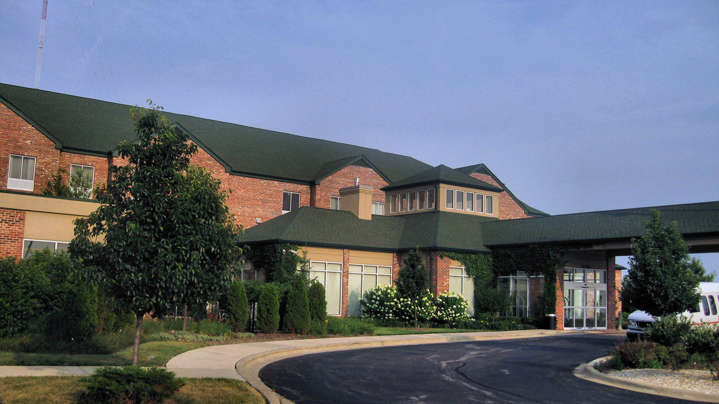

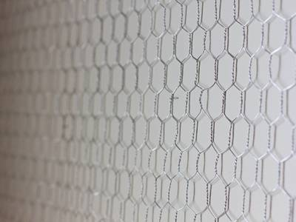
This really happens – one more story.
This is a success story -- EMC work preventing an interference problem.
Construction had begun on a hotel near an Interstate highway. After the building was framed, the builders noted a 450-foot radio tower next door for a 50,000-watt radio transmitter.
The construction company called the station and was told that it was a licensed broadcast site. An EMC engineer was contacted, and informed the builders that interference to electronic systems was likely, given the strong field in the area. Shielding the building was the most expeditious way to minimize risk.
The builders took the advice and worked with the EMC engineer on alternatives. They applied low-cost hardware cloth (chicken wire) to the outer walls and roof before adding siding and shingles. The screen was connected at multiple points to the building’s electrical ground.
When the hotel opened, no issues were found with the telephone, internet, alarm systems, and other electronics.

Slide 22
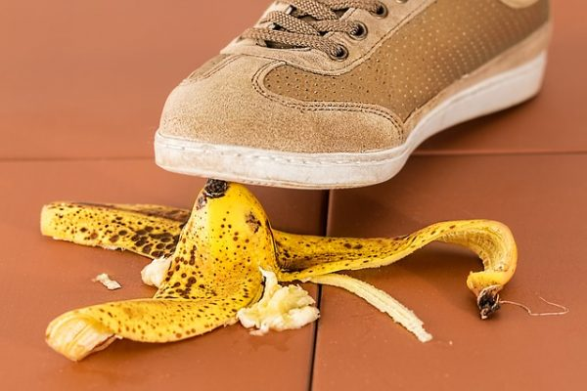

EMI happens -- there are plenty of stories.
An amazing collection of real-life EMC/EMI stories are collected in the Keith Armstrong’s Banana Skins archive:
incompliancemag.com/topics/magazine/
columns/banana-skins/
The FCC’s Spectrum Enforcement Division handles complaints of interference to licensed services:
https://www.fcc.gov/reports-research/
guides/interference-complaints
The current list of FCC Enforcement Actions are here:
https://www.fcc.gov/enforcement/orders

Slide 23

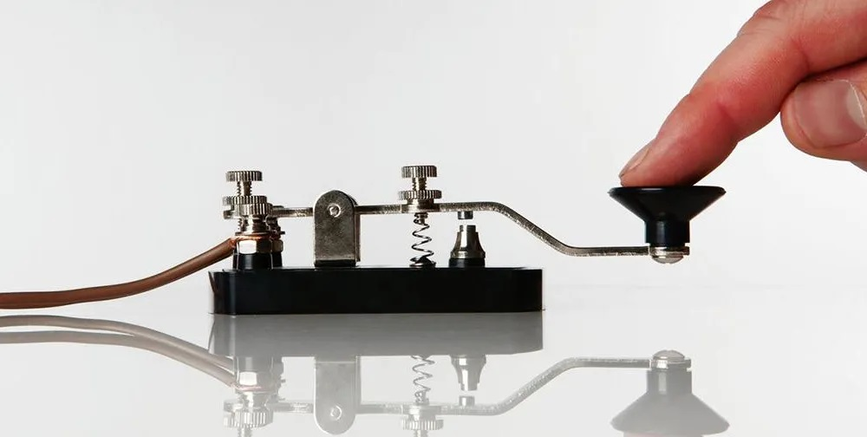
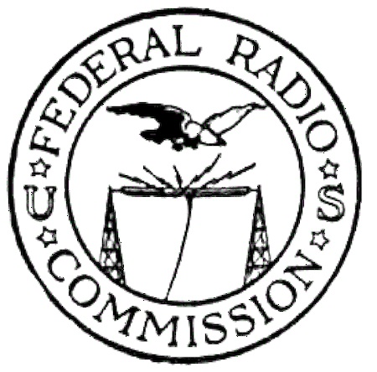
Standards and Regulations
Interference regulations go back to 1865 when the International Telegraph Union (ITU) set voluntary standards for wired-telegraph protocols.
After 1900, the ITU set basic standards for wireless telegraph.
In the US, the Radio Act of 1912 was passed in response to the sinking of the Titanic, requiring ships to have wireless telegraph capability and setting basic technical requirements.
In 1927, the US Federal Radio Commission was formed to set rules for the thousands of radio stations that had taken the air.
In 1934, the Federal Communications Commission (FCC) was established with a broader mandate to regulate radio, telephone, telegraph, and related technologies.

Slide 24
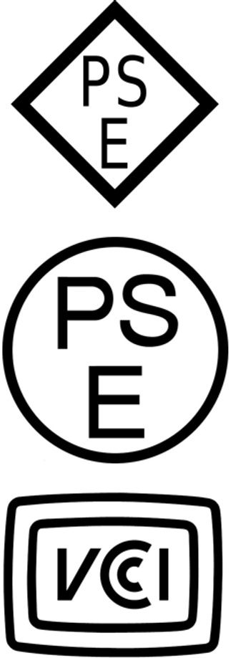
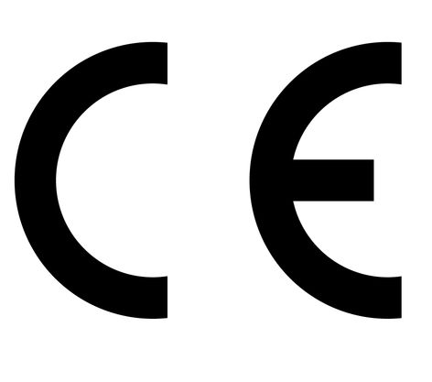










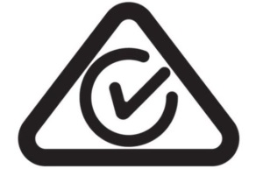
Standards and Regulations – Everywhere Else
Every country has its own set of regulations to minimize interference:
The EU’s CE Mark is required on products to show that EU EMC standards are met.
The UKCA Mark is for the UK.
The CCC Mark is for China.
The RCM Mark is for Australia.
The NOM Mark is for Mexico.
The VCCI Mark is for Japan.
The ANATEL Mark is for Brazil.
ISED is for Canada.
and on, and on, and on…
The technical requirements for all these countries are very similar. Differences are in frequency ranges and registration and filing requirements.

Slide 25
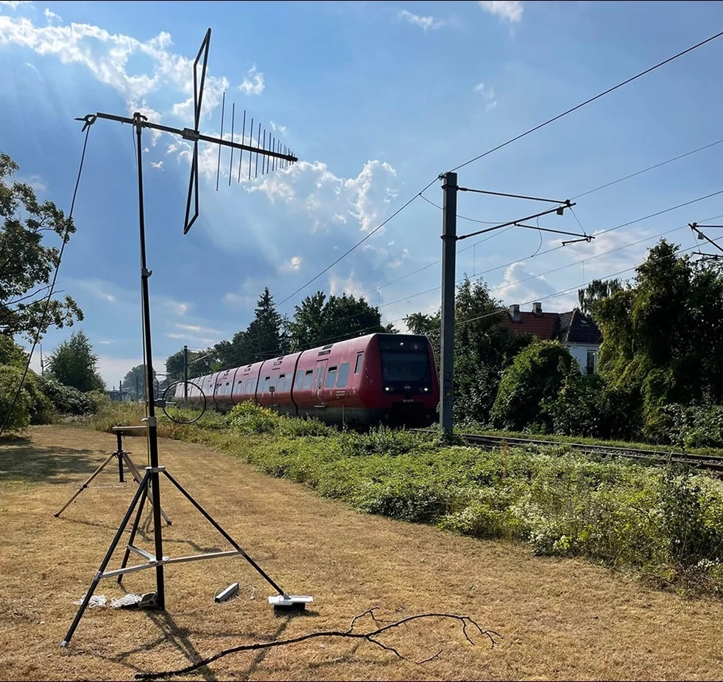
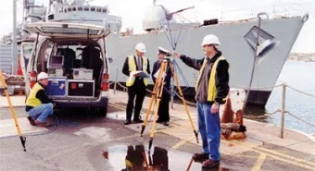
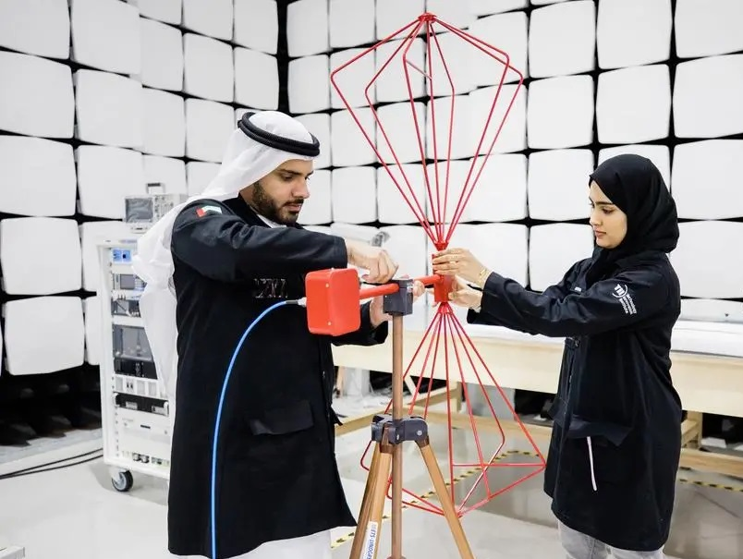
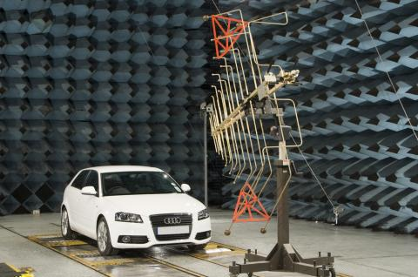
EMC as a Career
It’s fun
The stories related here describe colorful assignments and real-world puzzles to be solved.
Chasing EM interference puts the engineer in situations not found in the lab or the textbook.
Dealing with and resolving those assignments is satisfying, both for the engineer and the affected user.
It’s in demand
There aren’t nearly enough EMC engineers, and as more life-critical technologies rely on wireless tools, professionals with EMC skills become more critical, too.

Slide 26
Summary
EM compatibility is a goal. It’s always elusive, but it can be done, and has been done for 125 years.
EMC as a technology is a three-dimensional art that involves electrical engineering, creativity, a tolerance for variability, and a sense of humor.
EMC as a career puts the engineer on a broad continuum between mechanic and sorcerer, both of which are in high demand when there’s a non-compliance or an interference problem.
The relentless growth of wireless technology in medicine, transportation, information transfer, and commerce puts the highest premium on wireless expertise.
EMC is where that expertise is put to its highest use.

Slide 27
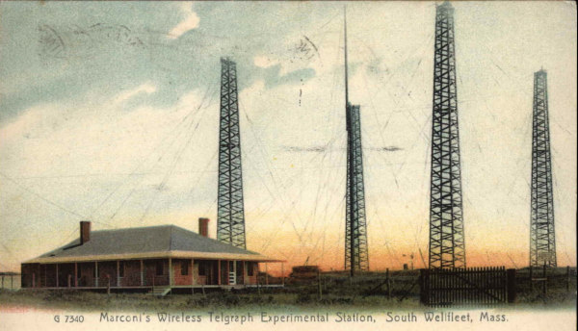
Thank you!
Questions?
tbraxton@ieee.org LinkedIn: Thomas Braxton

